Slide 1
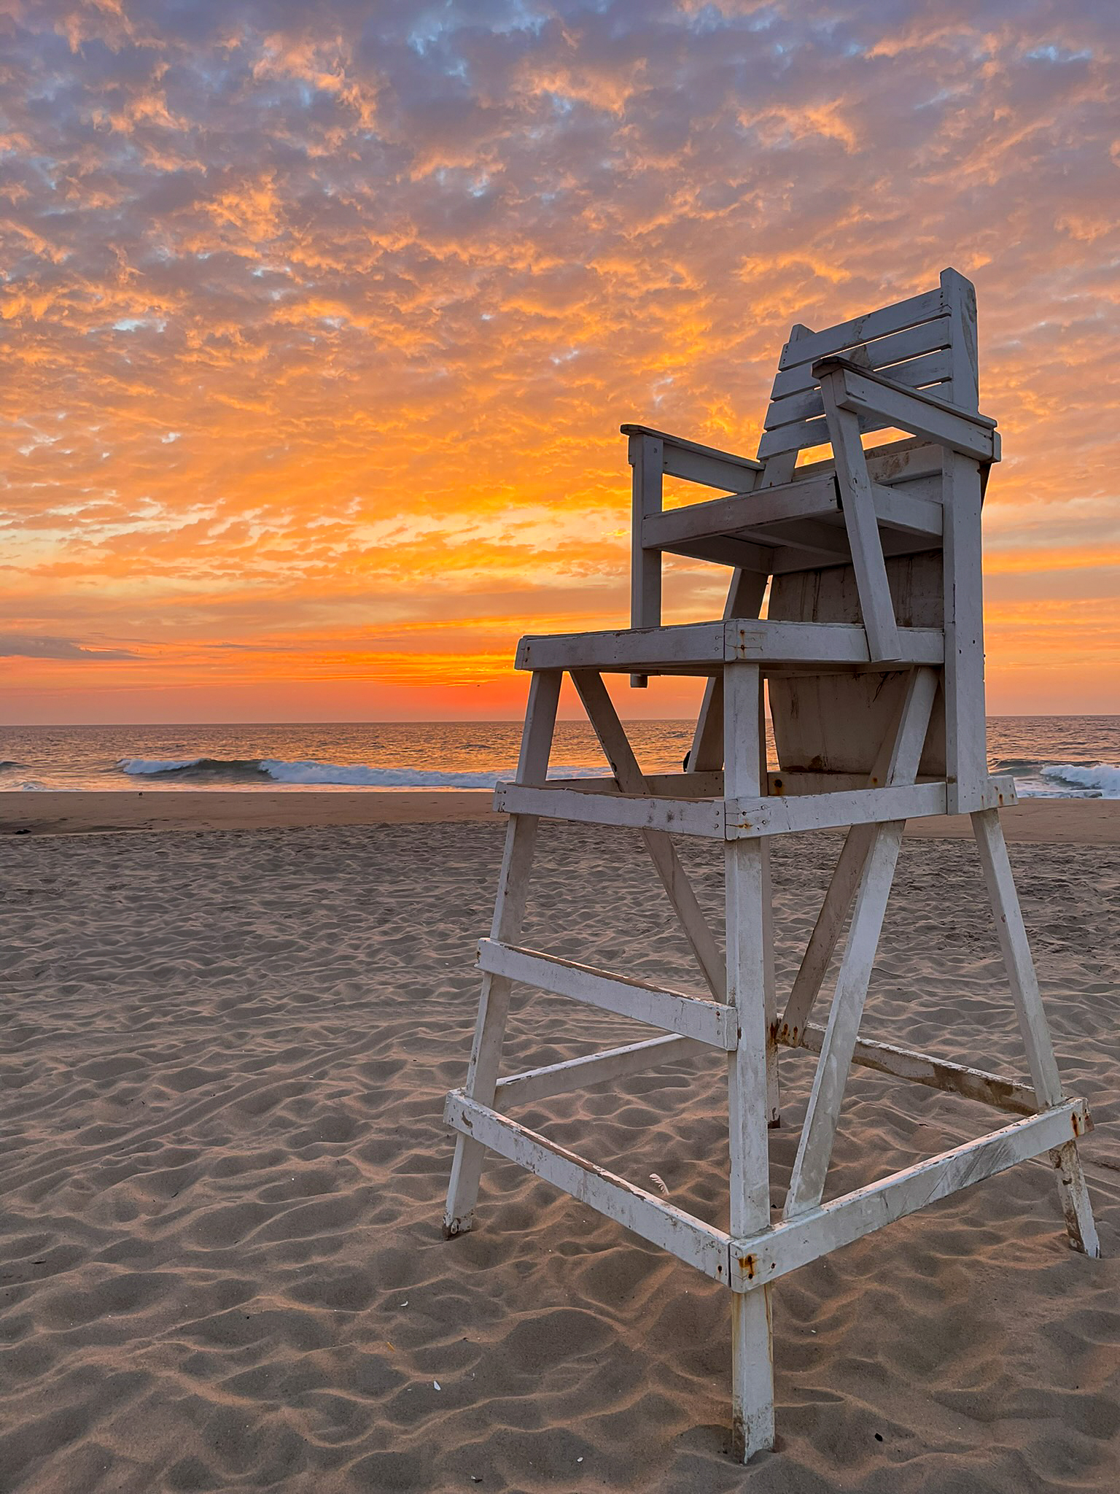
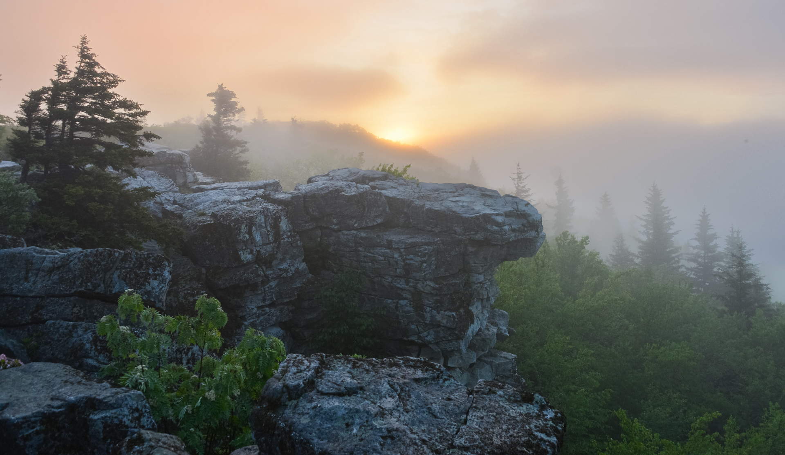
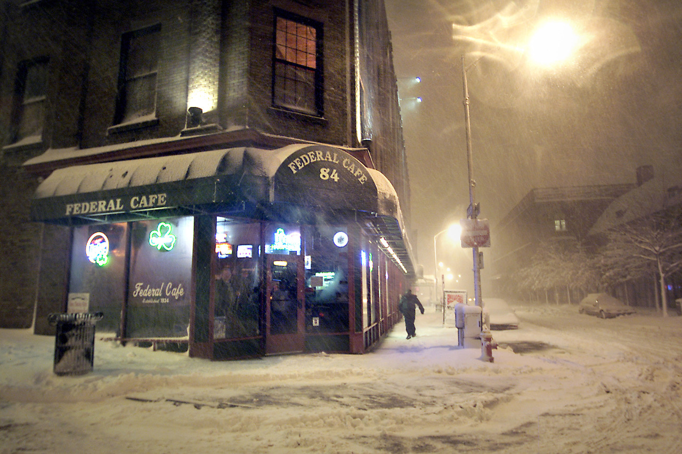
Rossmoor Camera Club Yearbook 2024 - 2025
Intermediate, Woody Shields, Dolly Sods
Advanced, John Long,
Snowbound at The Federal Cafe
General, Evelyn Brown, Ocean City Sunrise

Slide 2
2024 – 2025 Officers and Directors
President: Blair Blankinship
First Vice President and Chief Justice: Robert Schultz
Second Vice President and Chair of the Program Committee: Louis Paley
Treasurer: Woody Shields
Secretary: Judy MacArthur
Past-President: Stewart Lillard
Technology Support and Zoom Czar: Joanne Mars
Competition Coordinator: Woody Shields
Election Committee: Bob Kaplan
Webmaster: Blair Blankinship
LW News: Stewart Lillard

Slide 3
Photographers of the Year
Highest Ranked (by points accumulated as a result of club competitions held from September 2024 through April 2025):
ADVANCED
First: Joanne Mars Second: Judy MacArthur Third: Larry Mars
INTERMEDIATE
First: Emmy Vickers Second: Bob Schultz Third: Steve Goldenberg
GENERAL
First: Evelyn Brown Second: Helen Montfort Third (three way tie): David Mahler Lou Smith Jo Witt

Slide 4
Advanced – RCC Competitions 2024 - 2025
Photographer | September 2024 | October 2024 | November 2024 | January 2025 | February 2025 | March 2025 | April 2025 | Total
Blakney, Rick | 9 points |  | 15 points |  |  | 6 points |  | 30 points
Blankinship, Blair | 12 | 6 | 12 | 6 | 6 | 6 | 8 | 56
Kaplan, Bob |  |  |  |  | 9 | 8 | 6 | 23
Lillard, Stu |  |  |  |  | 6 |  |  | 6
Long, John |  |  | 10 | 18 |  |  | 16 | 44
MacArthur, Judy | 12 |  | 6 | 15 | 8 | 9 | 12 | 62
Mars, Joanne | 18 | 18 | 8 | 12 | 6 | 12 | 9 | 83
Mars, Larry | 6 | 15 | 6 | 6 | 16 | 10 |  | 59
Mason, Kent | 6 | 12 | 6 | 12 | 6 | 6 | 6 | 54
Tanenholtz, Al

Slide 5
Intermediate – RCC Competitions 2024 - 2025
Photographer | September 2024 | October 2024 | November 2024 | January 2025 | February 2025 | March 2025 | April 2025 | Total
Blakney, Cerina |  |  | 16 points | 8 points | 6 points |  | 15 points | 45 points
DeSchriver, Jean | 6 points |  |  |  |  |  |  | 6
Ferren, Ann | 8 | 16 |  |  | 6 |  |  | 30
Fife, John | 6 |  |  |  |  |  |  | 6
Friedman, Julie | 12 | 6 | 6 | 9 | 10 | 6 | 12 | 61
Goldenberg, Steve | 12 | 6 |  | 22 | 14 | 8 | 12 | 74
Kaplan, Ruthe | 6 | 15 |  | 12 |  | 16 |  | 49
Kurlandsky, Larry |  |  |  |  |  | 12 |  | 12
Paley, Louis | 12 |  |  |  |  | 6 |  | 18
Schultz, Bob | 16 | 20 | 12 | 6 | 12 | 9 | 8 | 83
Schwartz, Buddy |  |  | 6 |  |  |  | 6 | 12
Shields, Woody |  | 12 | 14 |  | 6 |  | 10 | 42
Thomas, Julie |  |  | 6 |  | 6 | 12 |  | 24
Vickers, Emmy | 9 |  | 21 | 12 | 21 | 12 | 12 | 87
Waller, Bill

Slide 6
General – RCC Competitions 2024 - 2025
Photographer | September 2024 | October 2024 | November 2024 | January 2025 | February 2025 | March 2025 | April 2025 | Total
Bosen, Rhona |  |  |  | 6 points |  |  | 8 points | 14 points
Brown, Evelyn | 19 points | 9 points | 10 points | 24 points | 8 points | 19 points | 16 points | 105 points
Clarke, Elizabeth
Heffler, Fran | 6 |  |  |  |  |  |  | 6
Kristal, Barbara |  |  | 6 | 6 |  |  |  | 12
Kristal, Joel | 14 |  | 12 | 6 |  |  |  | 32
Lipson, Paul
Livingston, Walt | 12 |  |  |  | 6 |  |  | 18
Mahler, David | 6 | 12 |  |  | 6 |  | 18 | 42
Montfort, Helen | 6 | 22 | 8 |  | 16 | 8 | 6 | 66
Reale, Regina
Roddy, Frank |  |  | 9 |  | 15 |  | 6 | 30
Shapiro, Fred | 6 | 8 |  |  |  |  |  | 14
Smith, Lou | 6 | 6 | 12 | 6 |  | 6 | 6 | 42
Witt, Jo | 6 |  | 6 | 21 |  |  | 9 | 42

Slide 7
Rossmoor Camera Club - Awards non-competitive Meritorious Service (occasional)
1977-78 Griff Chiles
1978-79 Lois Heginbotham
1982-83 Al Forziati
1984-85 John Aitchison
1985-86 Bill Courtright
1986-87 Rox & Elmore Chatham
1990-91 Lucile Fonda
1994-95 Maxine & Ken Svendsen
1996-97 Lewis William
1997-98 Carl Hawver
1998-99 Lewis Willman
1999-00 Louise Levin, Richard Carlson
2001-02 Mary & Phil Chenoweth, Art Drucker
2002-03 Lois Christeller
2003-04 Maxine & Ken Svendsen
2004-05 David Young
2008-09 Eugene Miller
2009-10 Pat & Chuck Bress
2011-12 David Young
2015-16 Richard Bambach
2016-17 Richard Bambach, Ron Masi
2017-18 George Kaye
2020-22 COVID-19 YEARS: Joanne Mars, Woody Shields, Rich Bambach, Bob Schultz, Steve Kline, Frank Roddy, Chris Warta, Bob Kaplan, Jon Fife
Outstanding Members
1987-88 Dorothea Felber
1988-89 John Aitchison
1989-90 Melrose Jesurun
1990-91 Bill Courtright
1991-92 Carl Hawver
1992-93 Elliot French
1993-94 Roz & Elmore Chatham
1994-95 Nancy Stiles, Lois Christeller

Slide 8
Photographer (s) of the Year, 2000 - 2014
Year | Digital | Print
1999 – 2000 |  | Lois Christeller
2000 – 2001 |  | Carl Hawver
2001 – 2002 | Larry Mars | Mark Ratner
2002 – 2003 | Larry Mars | Mark Ratner
2003 – 2004 | Larry Mars | Mark Ratner
2004 - 2005 | Larry Mars | Pat Bress (adv), Shirley Dibble (gen)
2005 – 2006 | Mark Ratner | Chuck Bress (adv), Bunny Ostrower (gen)
2006 – 2007 | Richard Bambach | Mark Ratner (adv), Frank Desmond (gen)
2007 – 2008 | Larry Mars (adv), Joanne Mars (gen) | Pat Bress (adv), Fred Shapiro (gen)
2008 – 2009 | Larry Mars (adv), Joanne Mars (gen) | Mark Ratner (adv), Joanne Book (gen)
2009 – 2010 | Joanne Mars (adv), Genie Sachs (gen) | Mark Ratner (adv), Joanne Mars (gen)
2010 – 2011 | Joanne Mars (adv), Algis Lukas (gen) | Chuck Bress (adv), Norm Petersen (gen)
2011 – 2012 | Joanne Mars (adv), Algis Lukas (gen) | Chuck Bress (adv), Joyce Stromberg (gen)
2012 – 2013 | Joanne Mars (adv), Jean DeSchriver (gen) | Brenda Gillum (adv), Joyce Stromberg (gen)
2013 - 2014 | Joanne Mars (adv), Nina Parish (gen) | Chuck Bress (adv), Robert Stromberg gen)

Slide 9
Photographer (s) of the Year, 2015 - 2025
Year | Digital | Print
2014 – 2015 | Joanne Mars (adv), Steven Kline (gen) | Chuck Bress (adv), Aggie Eastham (gen)
2015 – 2016 | Joanne Mars (adv), Louis Paley (gen) | Chuck Bress (adv), George Kaye (gen)
2016 – 2017 | Larry Mars (adv), Louis Paley (gen) | Mark Ratner (adv), Larry Mars (adv)
2017 – 2018 | Larry Mars (adv), Louis Paley (gen) & Robert Kaplan (gen) | Joanne Mars (adv), Gaby Dusan (gen)
2018 – 2019 | Joanne Mars (adv), Ruthe Kaplan (gen) & Ann Ferren (gen) | George Kaye (adv), Robert Kaplan (gen)
2019 – 2020 | Joanne Mars, (adv), Julie Friedman (gen) | Joanne Mars (adv), Ann Ferren (gen)
2020 – 2021 | George Kaye (adv), Woody Shields (gen) | NO PRINTS, COVID-19 YEAR
2021 – 2022 | Judy MacArthur (adv), Bob Schultz (gen) | NO PRINTS, COVID-19 YEAR
2022 – 2023 | Judy MacArthur (adv), Stu Lillard (gen) | NO PRINTS, COVID-19 YEAR
2023 – 2024 | Judy MacArthur (adv), Blair Blankinship (inter), Larry Kurlandsky (gen) | Prints suspended
2024 - 2025 | John Long (adv), Woody Shields (Int), Evelyn Brown (Gen)

Slide 10
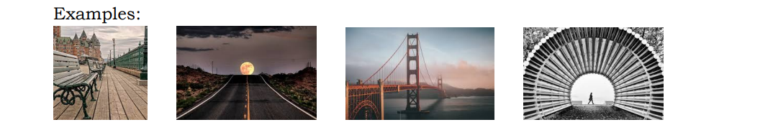
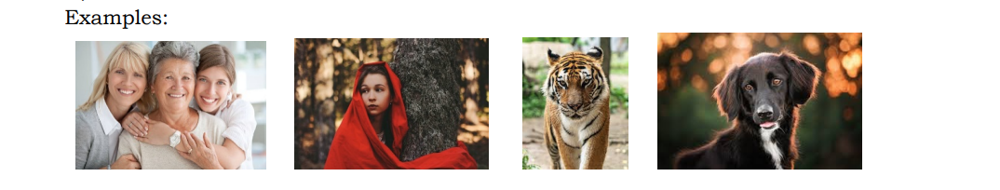
RCC Competition Subjects for 2024/2025
Sept. 24, 2024 - Open Subject: Competition open to all images. Post-processing allows for removal of distracting features, e.g., a limb of a tree or a passerby on the edge. However, no new images from another photo e.g., clouds in the sky, can be added.
Oct. 22, 2024 - Leading Lines – A photo that captures an image that naturally draws your eye towards a specific point of interest. Examples:
Nov. 26, 2024 - Faces: One or more human or animals faces. Exmples:
Jan. 28, 2025 – Open: Advanced techniques allowed, unrestrictive. Every image element must be from the submitting photographer.

Slide 11
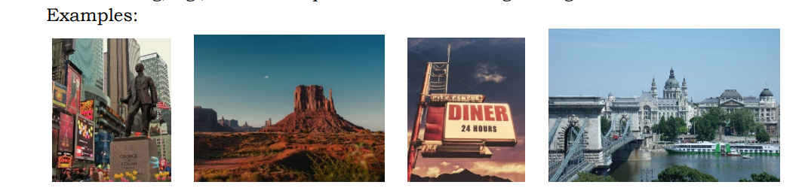
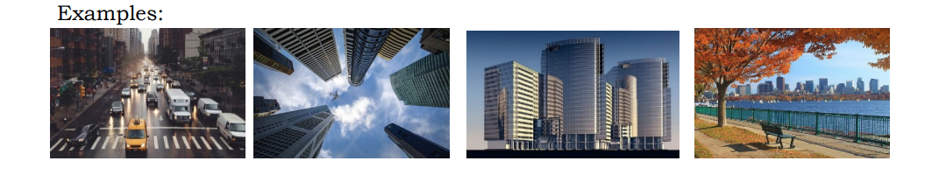
RCC Competition Subjects for 2024 - 2025
Feb. 25, 2025 - Travel: An image beyond 50 miles of Leisure World that portrays the land, buildings, people, or culture in its natural (not posed) state. This does not include images of the act or mode of traveling, e.g., inside an airplane or a train crossing a bridge.
March 25, 2025 – Cityscape: An image that captures urban landscapes, i.e. manmade features like streets and tall buildings are the focus of cityscape photography.
April 22, 2025 – End of Year: Up to three (3) images recognized by a judge in the 2024-25 competition.

Slide 12
RCC Meetings and Activities for 2024 - 2025
2024
July, 2024 Judy MacArthur, Larry Mars, Julie Thomas, Julie Friedman, Woody Shields complete an audit of the RCC Financials.
August 6, 2024 Board of Director Meeting
September 1, 2024 Louis Paley provided an exhibit of prints in the Gallery in Clubhouse 2, September - October, 2024
September 10, 2024 Program - Welcome and information. Club dues increased to $35.00 per year.
September 11, 2024 The new RCC website was launched. https://RossmoorCameraClubLW.com
September 13, 2024 The first of many Image Critiques is held, hosted by our Zoom Czar, Joanne Mars.
September 24, 2024 Competition – Open, but no new images from another Photo. Judge: Roz Kleffman
This is the first use of the new, revamped Competition Program for Windows 11.

Slide 13
RCC Meetings and Activities for 2024 - 2025
October 8, 2024 Maryland Photography Alliance (MPA) “How it Helps Maryland Photographers”; & “Shooting Faces of Humans & Animals” Steve Sattler, Louis Paley
October 14, 2024 First of many Lightroom Classes presented by Joanne Mars with assistance from Judy MacArthur.
October 17, 2024 LW Community Fair in CH I for LW clubs
October 22, 2024 Competition – Leading Lines – Judge: Vincent Farrer
November 9, 2024 Photographic Society of America (PSA) Program featuring AI photography, in Maryland Room, 9:00 AM until 3:00 PM
November 12, 2024 Program – Critique Prints; & How to Prepare & Mount Prints, presented by Stu Lillard and Judy MacArthur. RCC held a fund-raising raffle.
November 19, 2024 Board of Director Meeting
November 26, 2024 Competition – Faces – Judge: Ed Palaszynski
December 10, 2024 Holiday Dinner, in the Maryland Room at 6:00

Slide 14
RCC Meetings and Activities for 2024 - 2025
2025
January 1, 2025 John Long provided an exhibit of prints in the Gallery in Clubhouse 2. January - February 2025
January 7, 2025 Program - Taking Great Photos with a Smartphone. David Luria of Washington Photo Safari
January 22, 2025 Joanne and Larry Mars offer a Photo Presentation to Leisure World Residents and guests in the Maryland Room.
January 21, 2025 Competition - Open Subject: Advanced techniques, composite images Allowed –
Judge: Michael Brown
February 11, 2025 Program - “Still Lifes – Beyond Fruit Bowls and Flowers” Betsy Wilson Photo, via Zoom.
February 25, 2025 Competition – Travel beyond 50 miles – Judge Frank Gallagher
March 11, 2025 Program – “How to Overcome Tough Shooting Conditions” Louis Paley
March 25, 2025 Competition – Cityscape – Judge: Matthew Mahlstedt

Slide 15
RCC Meetings and Activities for 2024 - 2025
April 1, 2025 Board of Director Meeting
April 8, 2025 Program – Using Fastone Viewer to edit digital images, presented by Louis Paley
April 22, 2025 Competition - End of Year: Up to three (3) images recognized by a judge in the 2024-25 competition. Judge: Ronald Peiffer
May 1, 2025 Joanne and Larry Mars provided an exhibit of prints in the Gallery in Clubhouse 2, May - June 2025
May 13, 2025 RCC Annual Meeting and Banquet, in the Maryland Room at 6:00.
May 15, 2025 Very successful LW Community Fair in CH I for LW clubs.

Slide 16
History
ROSSMOOR CAMERA CLUB (MD), a continuous member of the PHOTOGRAPHIC SOCIETY OF AMERICA (PSA) since 1968.
Leisure World of Maryland was set aside for community use and placed in trust, March 9, 1966.
By April of 1966, co-operative units were available for occupancy.
In February 1968, Leisure World made a darkroom (in Clubhouse One) available to resident photographers seeking a quiet place to develop and print photos.

Slide 17
PRESIDENTS of the ROSSMOOR CAMERA CLUB
1968-69, James C. McCutcheon & Walter L. Greene
1970, William E. Meeds
1971, C. Bill Courtright
1972, Charles C. Limburg
1973, Benn C. Comstock
1974-75, Emerson M. Brooks
1975-76, Ferd A. Dreher
1976-77, Beverley G. Fonda
1977-78, Elmore R. Chatham
1978-80, Miriam N. Ulrich
1980-81, Beverley G. Fonda
1981-82, Dorothea Felber
1982-84, Robert H. Carleton
1984-85, Dorothy L. McCarthy
1985-86, John G. Marvin
1986-87, Lucile L. Fonda
1987-88, Carl Hawver
1988-89, Albert Mapou
1989-90, Lucile L. Fonda
1990-91, Moe Greenspan
1991-92, C. Bill Courtright
1992-93, Frances DuBois
1993-94, Melrose Jesurun
1994-95, Richard Carlson
1995-96, Nancy Stiles
1996-97, Nancy Stiles and Hope Pantell
1997-99, Lois Christeller
1999-2001, Julia Sulsky
2001-02, Virginia Winborne
2002-03, Norman Petersen
2003-06, Mary Chenoweth
2006-08, David Young
2008-09, Chuck Bress

Slide 18
PRESIDENTS of the ROSSMOOR CAMERA CLUB
2009 -11, David Young
2011 -12, Richard Bambach
2012 -16, Stewart Lillard
2016 -18, Jon Fife
2018 -24, Stewart Lillard
2024 -25, Blair Blankinship

